Slide 1



19CSE301 COMPUTER NETWORKS
3-0-0 4

Slide 2
Network Edge
Access Networks
Physical Media

Slide 3
Physical Media
Twisted-Pair Copper Wire
Coaxial Cable
Fiber Optics
Terrestrial Radio Channels
Satellite Radio Channels

Slide 4
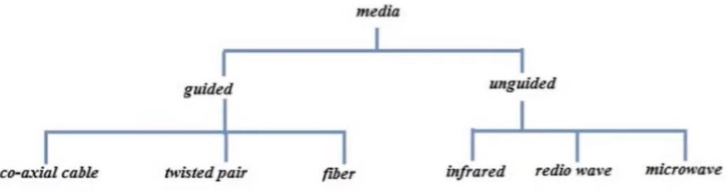
Transmission Media
Guided Media:
It is also referred to as Wired or Bounded transmission media. Signals being transmitted are directed and confined in a narrow pathway by using physical links.
Features:
High Speed
Secure
Used for comparatively shorter distances

Slide 5
Physical Media
Network media is the actual path over which an electrical signal travels as it moves from one
component to another
Examples of physical media
Twisted-pair Copper wire,
Coaxial cable,
Multimode fiber-optic cable,
Unguided ( Radio, Microwave, Infrared, light)
Physical media fall into two categories: guided media and unguided media.
With guided media, the waves are guided along a solid medium, such as a fiber-optic cable, a twisted-
pair copper wire, or a coaxial cable.
With unguided media, the waves propagate in the atmosphere and in outer space, such as in a wireless LAN or a digital satellite channel.The bit is sent by propagating electromagnetic waves or optical pulses across a physical medium.

Slide 6
Guided Media
Twisted-Pair Copper Wire
Coaxial Cable
Fiber Optics

Slide 7
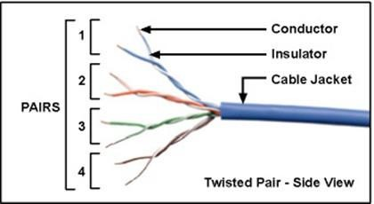
Twisted-Pair Copper Wire
The least expensive and most commonly used guided transmission medium, dominant solution for high-speed LAN networking
Twisted pair consists of two insulated copper wires, each about 1 mm thick, arranged in a regular spiral pattern. The wires are twisted together to reduce the electrical interference from similar pairs close by. Typically, a number of pairs are bundled together in a cable by wrapping the pairs in a protective shield. A wire pair constitutes a single communication link.
Unshielded twisted pair (UTP) is commonly used for computer networks within a building, that is, for LANs
Data rates for LANs using twisted pair today range from 10 Mbps to
10 Gbps.
The data rates that can be achieved depend on the thickness of the wire and the distance between transmitter and receiver
Twisted-pair cable is a type of cabling that is used for telephone communications and most modern Ethernet networks.
Dial-up modem technology enables access at rates of up to 56 kbps over twisted pair
DSL (digital subscriber line) technology has enabled residential users to access the Internet at tens of Mbps over twisted pair

Slide 8
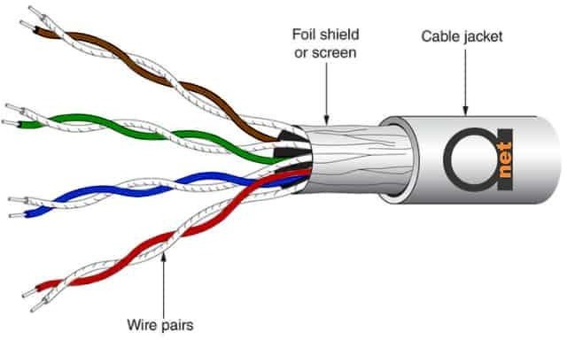
Twisted-Pair (UTP, STP)
A pair of wires forms a circuit that can
transmit data. The pairs are twisted to
provide protection against crosstalk, the noise generated by adjacent pairs.
When electrical current flows through
a wire, it creates a small, circular magnetic field around the wire.
When two wires in an electrical circuit
are placed close together, their
magnetic fields are the exact opposite
of each other. Thus, the two magnetic fields cancel each other out.
They also cancel out any outside
magnetic fields. Twisting the wires can enhance this cancellation effect.
Using cancellation together with
twisting the wires, cable designers can
effectively provide self-shielding for
wire pairs within the network media.
Shielded Twisted Pair ( STP)
In TP cable, each pair is represented by a specific color. Pair 1 is Blue, Pair 2 is Orange, Pair 3 is Green, and Pair 4 is Brown

Slide 9
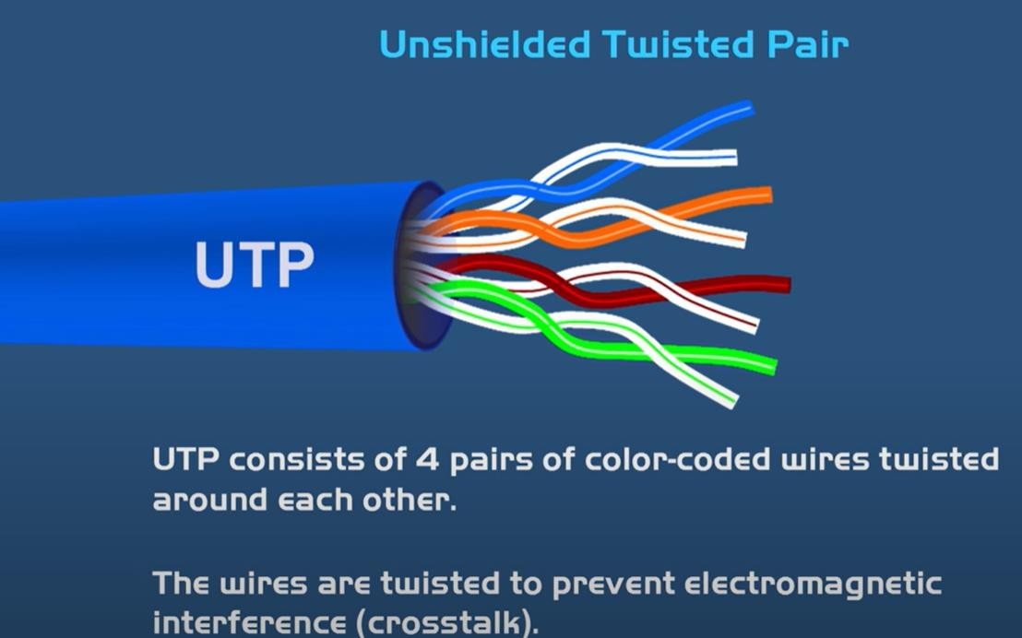
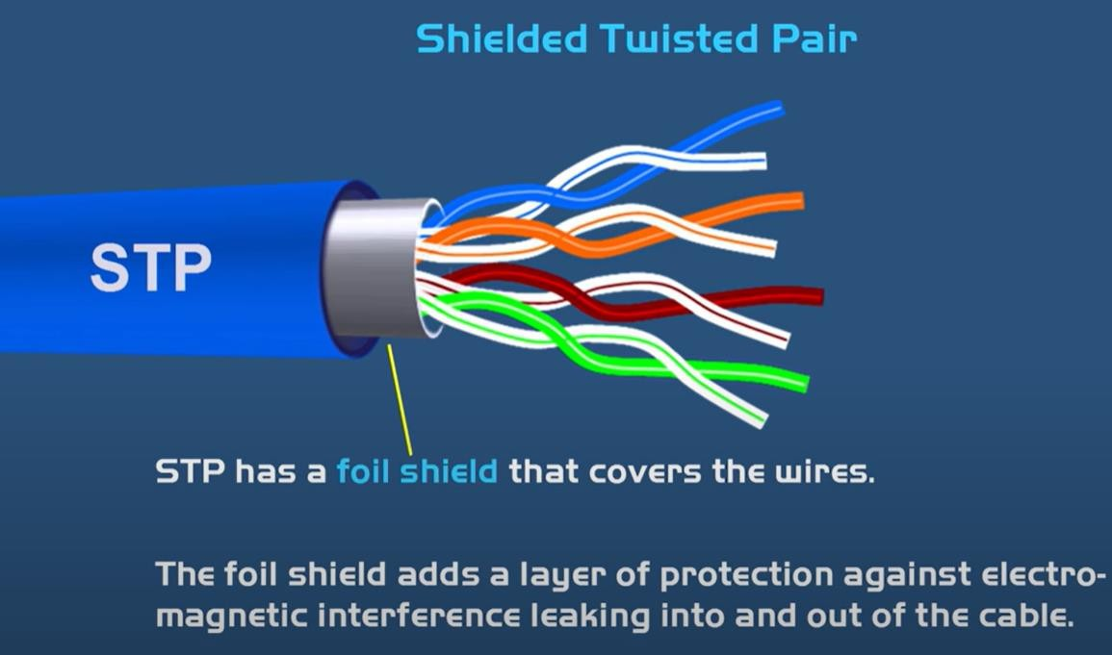
Twisted-Pair
Shielded Twisted Pair (STP):
This type of cable consists of a special jacket to block external interference. It is used in fast-data-rate Ethernet and in voice and data channels of telephone
lines. Advantages:
Better performance at a higher data rate in comparison
to UTP
Eliminates crosstalk
Comparatively faster
Comparatively difficult to install and manufacture
More expensive
Bulky
Unshielded Twisted Pair (UTP):
This type of cable has the ability to block interference and does not depend on a physical shield for this purpose. It is used for telephonic applications. Advantages:
Least expensive
Easy to install
High-speed capacity
Susceptible to external interference
Lower capacity and performance in comparison to STP
Short distance transmission due to attenuation
Courtesy: PowerCert Animation

Slide 10
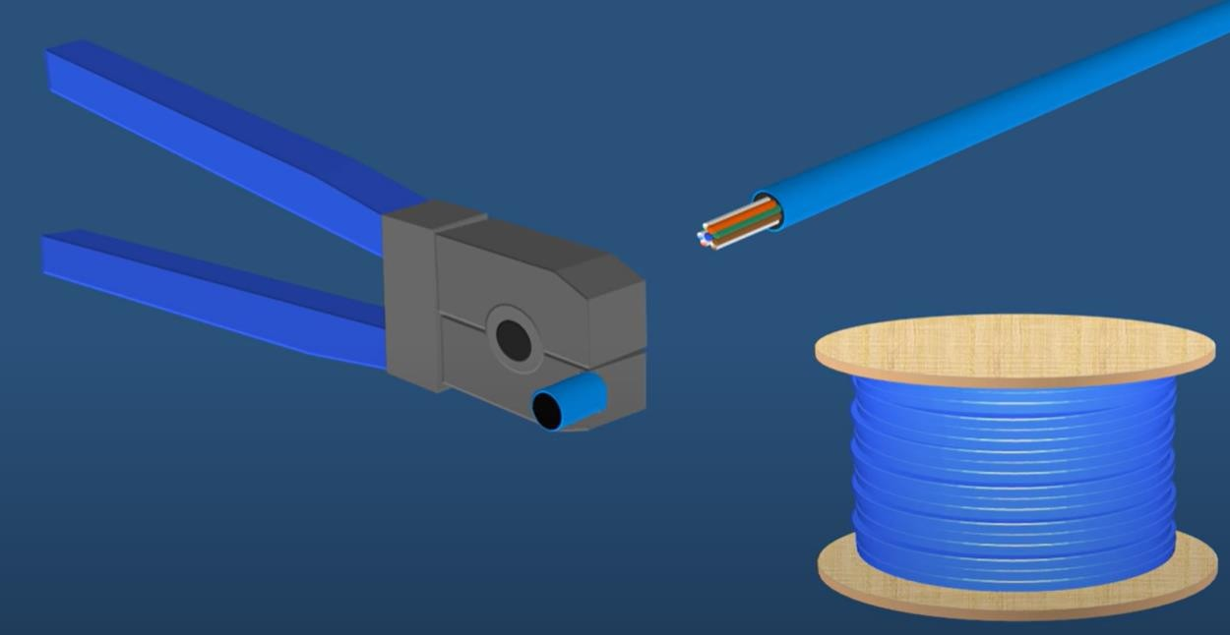
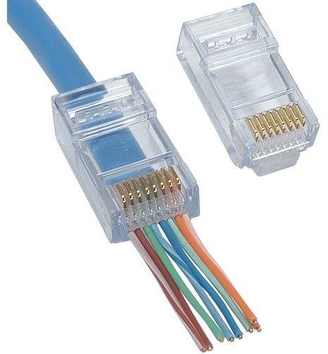
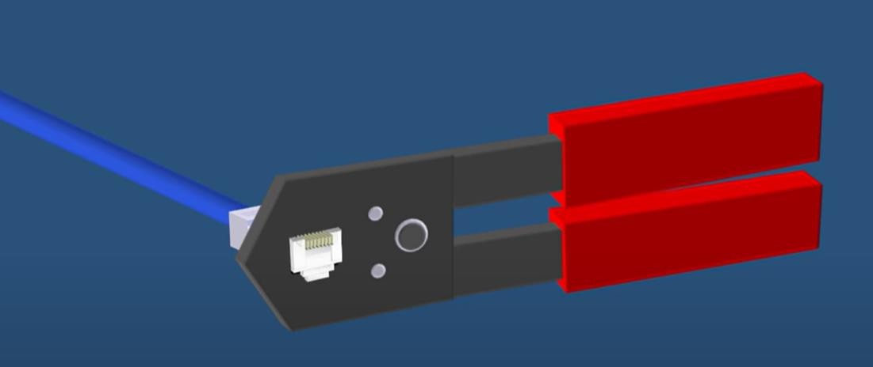

Twisted-Pair- RJ45 Connector
A cable stripper used to remove the shield and expose cable
A block row of twisted pair cable
RJ45 Connector
RJ45 connector attached using a wire cripper
Courtesy: PowerCert Animation

Slide 11

Twisted-Pair: 568A and 568B
There are two major Unshielded Twisted Pair Cable wiring standards used widely in networking industry.
... TIA/EIA 568A and TIA/EIA-568B standards determine the order of the wires placed in the RJ45
connector.
Courtesy: PowerCert Animation

Slide 12
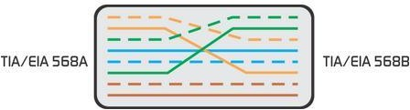
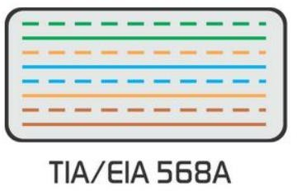
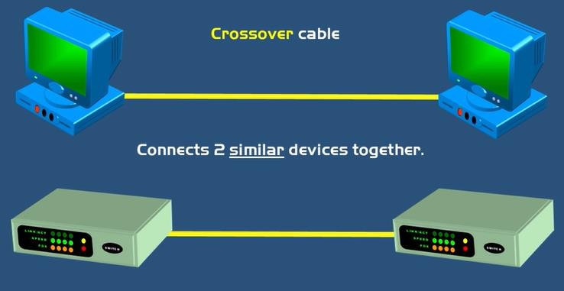
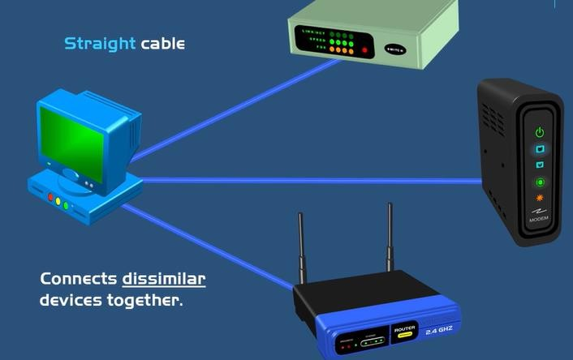
Twisted-Pair -Straight through/ Cross over
crossover cable
Straight Through cable
Courtesy: PowerCert Animation

Slide 13
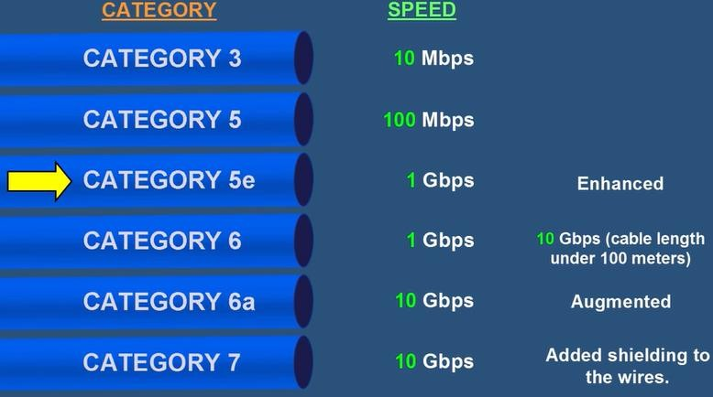
Twisted Pair categories
Courtesy: PowerCert Animation
Modern twisted-pair technology, such as category 6a cable, can achieve data rates of 10 Gbps for distances
up to a hundred meters

Slide 14
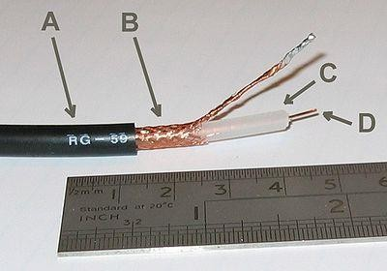
Coaxial Cable
It has an outer plastic covering containing 2 parallel conductors each having a separate insulated protection cover. The coaxial cable transmits information in two modes: Baseband mode(dedicated cable bandwidth) and Broadband mode(cable bandwidth is split into separate ranges). Cable TVs and analog television networks widely use Coaxial cables.
Advantages:
High Bandwidth
Better noise Immunity
Easy to install and expand
Inexpensive
Disadvantages:
Single cable failure can disrupt the entire network
Coaxial cable is commonly used by cable operators, telephone companies,

Slide 15
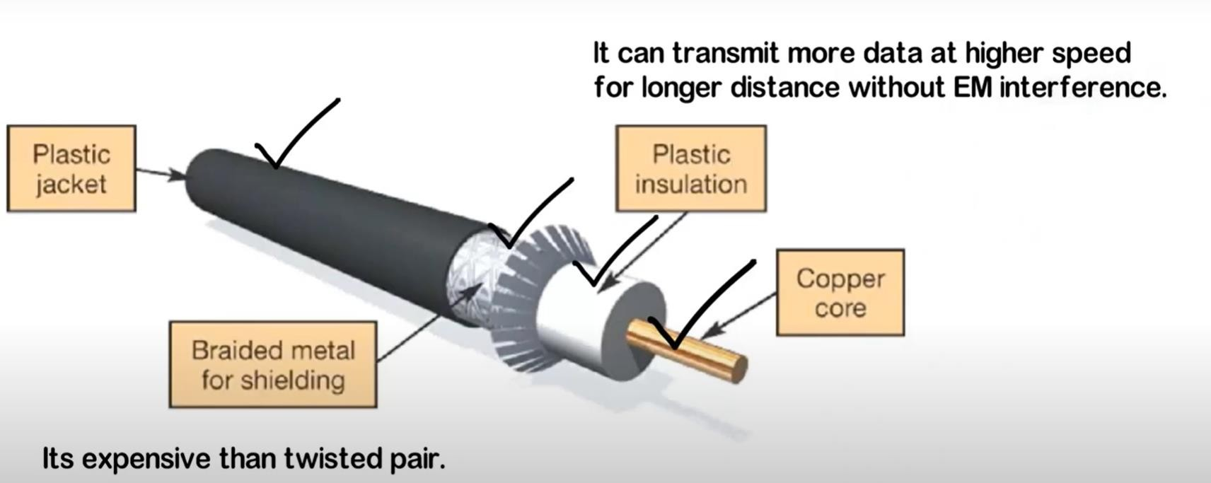

Coaxial Cable

Slide 16
Coaxial Cable
Coaxial cable supports 10 to 100 Mbps and is relatively inexpensive, although it is more costly than UTP on a per-unit length.
For LANs, coaxial cable offers several advantages. It can be run with fewer boosts from repeaters for longer distances between network nodes than either STP or UTP cable. Repeaters regenerate the signals in a network so that they can cover greater distances. Coaxial cable is less expensive than fiber-optic cable,
Thicknet and Thinnet (sometimes called ThickWire and ThinWire) are commonly used terms for the larger and smaller size
of coaxial cable used in Ethernet local area networks
The most common connectors used with Thinnet are BNC
Coaxial cable consists of a hollow outer cylindrical conductor that surrounds a single inner wire made of two conducting elements.
One of these elements, located in the center of the cable, is a copper conductor. Surrounding the copper conductor is a layer of flexible insulation.
Over this insulating material is a woven copper braid or metallic foil that acts both as the second wire in the circuit and as a shield for the inner conductor.
This second layer, or shield, can help reduce the amount of outside interference. Covering this shield is the cable jacket

Slide 17
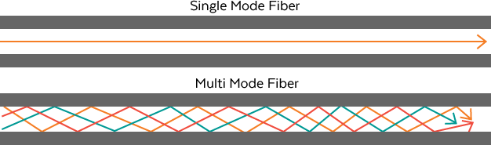
Optical Fibre Cable
An optical fiber is a thin, flexible medium that conducts pulses of light, with each pulse representing a bit.
It uses the concept of reflection of light through a core made up of glass or plastic. The
core is surrounded by a less dense glass or plastic covering called the cladding. It is used for the transmission of large volumes of data.
The cable can be unidirectional or bidirectional. The WDM (Wavelength Division
Multiplexer) supports two modes, namely unidirectional and bidirectional mode.
Advantages:
Increased capacity and bandwidth
Lightweight
Less signal attenuation
Immunity to electromagnetic interference
Resistance to corrosive materials
Disadvantages:
Difficult to install and maintain
High cost
Fragile
Single-mode fiber cables use laser light to send signals, and they are thinner than multi-mode fiber cables. Light-emitting diodes (LEDs) are used to send signals in multi-mode fiber cables, and multi-mode cables are usually used over short distances. Data transfer rates between 10 Mbps to 10 Gbps are the norm.

Slide 18
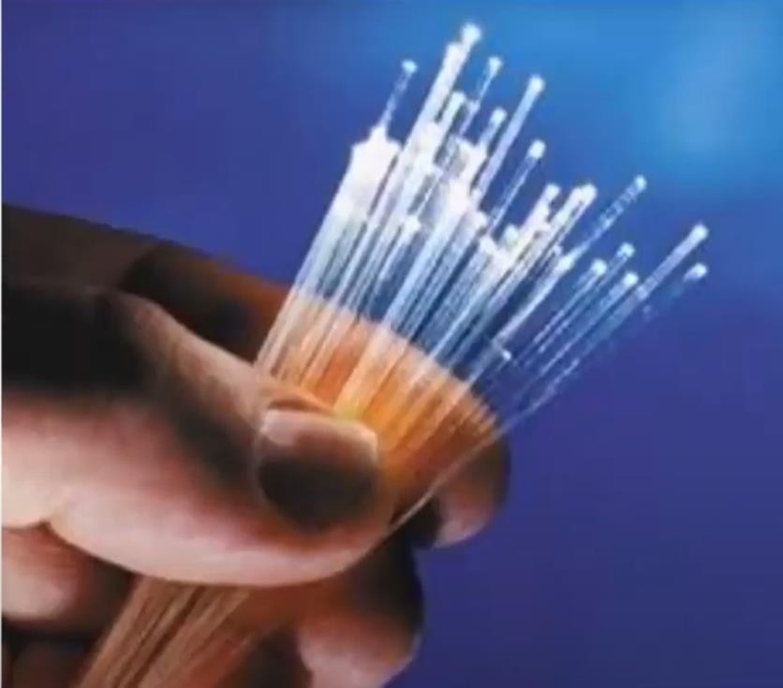
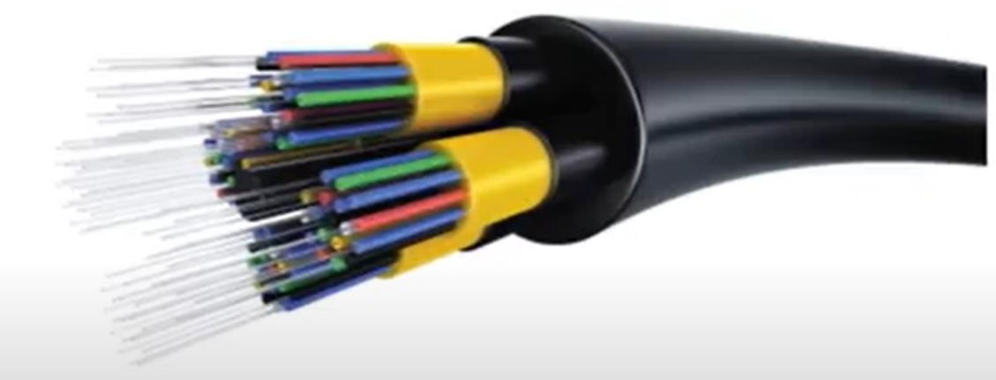
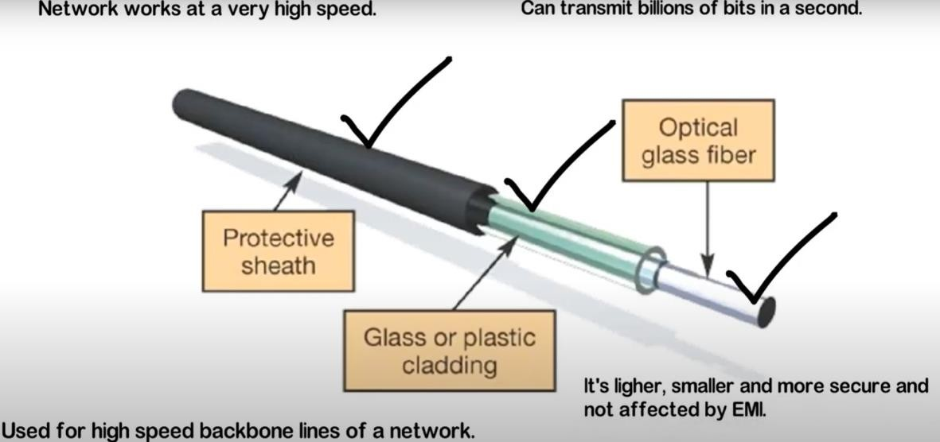
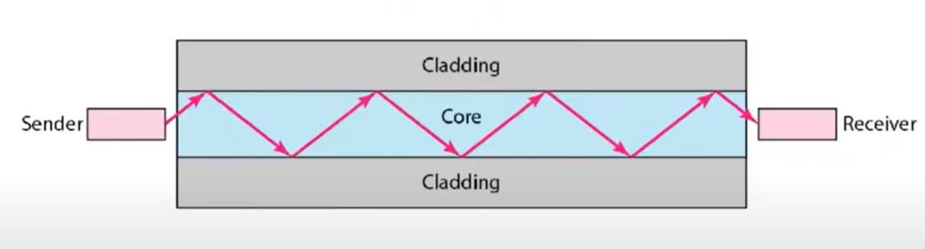
Fibre Optic Cables
Refraction

Slide 19
Comparison
Media Type | Maximum Segment Length | Speed | Cost | Advantages | Disadvantages
UTP | 100 m | 10 Mbps to 1000 Mbps | Least expensive | Easy to install; widely available and widely used | Susceptible to interference; can cover only a limited distance
STP | 100 m | 10 Mbps to 100 Mbps | More expensive than UTP | Reduced crosstalk; more resistant to EMI than Thinnet or UTP | Difficult to work with; can cover only a limited distance
Coaxial | 500 m (Thicknet) 185 m (Thinnet) | 10 Mbps to 100 Mbps | Relatively inexpensive, but more costly than UTP | Less susceptible to EMI interference than other types of copper media | Difficult to work with (Thicknet); limited bandwidth; limited application (Thinnet); damage to cable can bring down entire network
Fiber-Optic edium is possibly th twork. The choice | 10 km and farther (single-mode) 2 km and farther (multimode) e single most importan of media type will affect | 100 Mbps to 100 Gbps (single mode) 100 Mbps to 9.92 Gbps (multimode) t long-term investmen the type of NICs inst | Expensive (Single mode Expensive than multimode) t made alled, the | Cannot be tapped, so security is better; can be used over great distances; is not susceptible to EMI; has a higher data rate than coaxial and twisted- pair cable
The m in a ne
speed of the network, and the capability of the network to meet future needs.

Slide 20
Unguided Media ( wireless)
Radio waves
Microwave waves
Infrared waves
Light waves

Slide 21
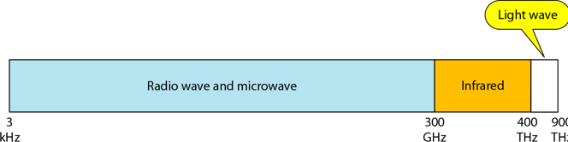
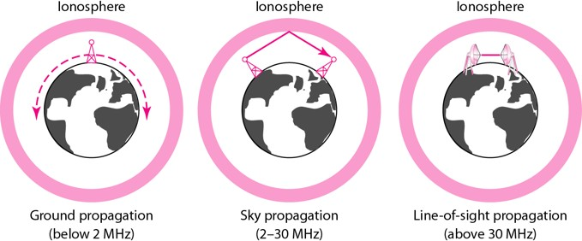
Unguided Media
Unguided medium transport electromagnetic waves without using a physical conductor. This type of communication is often referred to as wireless communication. Signals are normally broadcast through free space and thus are available to anyone who has a device capable of receiving them.
Ground Propagation: In this, radio waves travel through the lowest portion of the atmosphere, hugging the Earth. follow the curvature of the planet.
Sky Propagation: In this, higher-frequency radio waves radiate upward into the ionosphere where they are reflected back to Earth. allows for greater distances with lower output power.
Line-of-sight Propagation: in this type, very high- frequency signals are transmitted in straight lines directly from antenna to antenna.

Slide 22
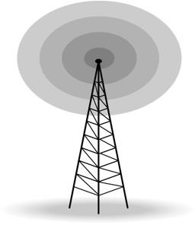
Radio Waves
Electromagnetic waves ranging in frequencies between 3 KHz and 1 GHz are normally called radio waves.
Applications of Radio Waves
The omnidirectional characteristics of radio waves make them
useful for multicasting in which there is one sender but many
receivers.
AM and FM radio, television, maritime radio, cordless phones, and paging are examples of multicasting.

Slide 23
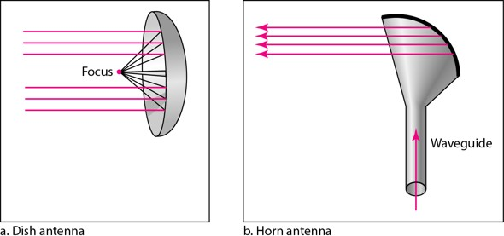
Micro Waves
Electromagnetic waves having frequencies between 1 and 300 GHz are called micro waves. Micro waves are unidirectional. When an antenna transmits microwaves, they can be narrowly focused
Microwave propagation is line-of-sight.
Very high-frequency microwaves cannot penetrate walls The microwave band is relatively wide, almost 299 GHz
Applications of Micro Waves
Microwaves, due to their unidirectional properties, are very useful when unicast(one-to-one) communication is needed between the sender and the receiver. They are used in cellular
phones, satellite networks and wireless LANs. There are 2 types of Microwave Transmission : 1.Terrestrial Microwave
2.Satellite Microwave
Unidirectional Antenna for Micro Waves

Slide 24
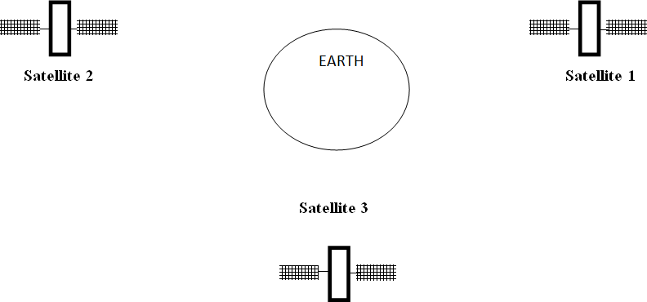
Microwave Transmission
2 types of Microwave Transmission :
Terrestrial Microwave 2.Satellite Microwave
Satellite Microwave
This is a microwave relay station which is placed in outer space. The satellites are launched either by rockets or space shuttles carry them.
Two types of satellites are used in communications:
geostationary satellites
low-earth orbiting (LEO) satellites
Geostationary satellites
Permanently remain above the same spot on Earth.
This stationary presence is achieved by placing the satellite in orbit at 36,000 kilometers above Earth’s surface
substantial signal propagation delay of 280 milliseconds
LEO satellites
Placed much closer to Earth and do not remain permanently above one spot on Earth.
They rotate around Earth and may communicate with
each other, as well as with ground stations.
To provide continuous coverage to an area, many satellites need to be placed in orbit

Slide 25
Infrared Waves
Infrared waves, with frequencies from 300 GHz to 400 THz, can be used for short-range communication. Infrared waves, having high frequencies, cannot penetrate walls. This advantageous characteristic prevents interference between one system and another, a short-range communication system in on room cannot be affected by another system in the next room.
Applications of Infrared Waves
The infrared band, almost 400 THz, has an excellent potential for data transmission. Such a wide bandwidth can be used to transmit digital data with a very high data rate.
Infrared signals can be used for short-range communication in a closed area using line-of-sight propagation. Very
secure
Used in TV remote , AC remote, Automatic Door, wireless speakers

Slide 26





